Slide 1
Literature review

Slide 2
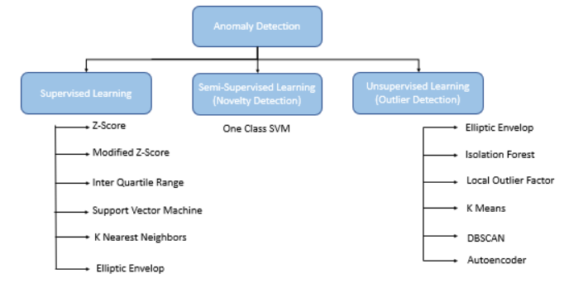
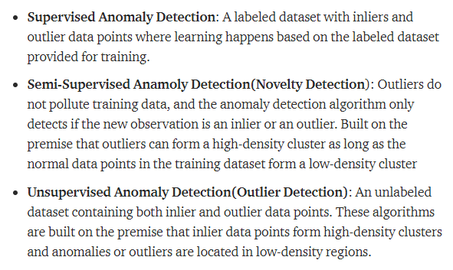
В интернетах, но не в статьях
Простые z-score, квартили >3, boxplots, DBSCAN, Автоэнкодеры (возможно в статьях, но Use only normal transactions to train the Autoencoder. СМОТРИ КАРТИНКУ)
Anomaly Detection Techniques: Part 1 | by Renu Khandelwal | The Startup | Medium https://medium.com/swlh/anomaly-detection-techniques-part-1-962b0494f9cf

Slide 3
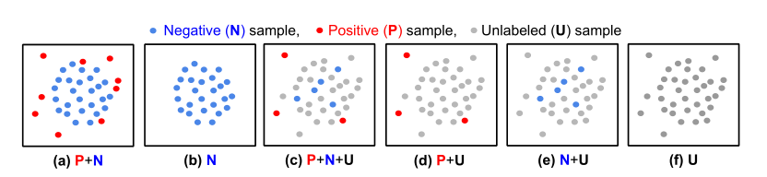
Self-Trained One-class Classification for Unsupervised Anomaly Detection
Unlabeled setting has received relatively less attention despite its significance in automating machine learning. Two of the most popular methods for this setting are isolation forest [31] and local outlier factor [11], but they are hard to scale and less compatible with recent advances in representation learning. While one-class classifiers, such as OC-SVM, SVDD, or their deep counterparts, apply to unlabeled settings by assuming the data is all negative, and the robustness of those methods has also been demonstrated in part [48, 5], in practice we observe a significant performance drop with a high anomaly ratio, as shown in Fig. 2. Our proposed framework mostly recovers the lost performance of state-of-the-art shallow and deep one-class classifiers trained on unlabeled data.
[31] – F. T. Liu, K. M. Ting, and Z.-H. Zhou. Isolation forest. In 2008 eighth ieee international conference on data mining, pages 413–422. IEEE, 2008. 2, 3
[11] - M. M. Breunig, H.-P. Kriegel, R. T. Ng, and J. Sander. Lof: identifying density-based local outliers. In Proceedings of the 2000 ACM SIGMOD international conference on Management of data, pages 93–104, 2000. 3
[48] - B. Zong, Q. Song, M. R. Min, W. Cheng, C. Lumezanu, D. Cho, and H. Chen. Deep autoencoding gaussian mixture model for unsupervised anomaly detection. In International Conference on Learning Representations, 2018. 1, 2, 3, 5, 6

Slide 4
One-Class Classification for Anomaly Detection with Kernel Density Estimation and Genetic Programming
Tax and Duin [28,29] proposed a method called Support Vector Data Description (SVDD) to solve the problem of OCC. In the method, a hypersphere with minimum radius around the target examples in feature space is found, which encompasses almost all target instances.
Sch¨olkopf [21,22] presented an alternative approach called one-class SVM. The one-class classifier is achieved by searching for a hyperplane with a maximum margin between the region containing target data and the origin in feature space. The target data is again mapped to feature space via a kernel.

Slide 5
One-Class Classification for Anomaly Detection with Kernel Density Estimation and Genetic Programming
Cuong To [31] proposed a different approach to one-class problem by calculating the sum of the Euclidean distance from a target point to all target examples with an assumption that the distribution of the summed distance is normal. This is similar to an inversion of a kernel method since a kernel is a similarity whereas a Euclidean distance is a dissimilarity. They then used GP to approximate this sum. They then used two thresholds at 2.5 % and 97.5 % on training dataset to classify new examples. New points whose sum of distances was below the 2.5 percentile or above the 97.5 percentile of the data were classed as anomalies.

Slide 6
A popular method for anomaly detection is to use the generator of an adversarial network to formulate anomaly score over reconstruction loss of input. Due to the rare occurrence of anomalies, optimizing such networks can be acumbersome task.
Another possible approach is to use both generator and discriminator for anomaly detection

Slide 7
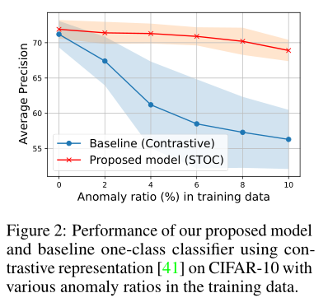
Actuality
Some recent studies [48, 5] have evaluated their one-class classifiers for unsupervised AD settings, but their performance has been suboptimal. To illustrate this, we evaluate the unsupervised AD performance of state-of-the-art deep one-class classifier [41] with different anomaly ratios in unlabeled training data. As shown in Fig. 2, the average precision significantly drops even when a small portion (2%) of training data is contaminated with anomalies.
Notes:
Self-Trained One-class Classification for Unsupervised Anomaly Detection

Slide 8
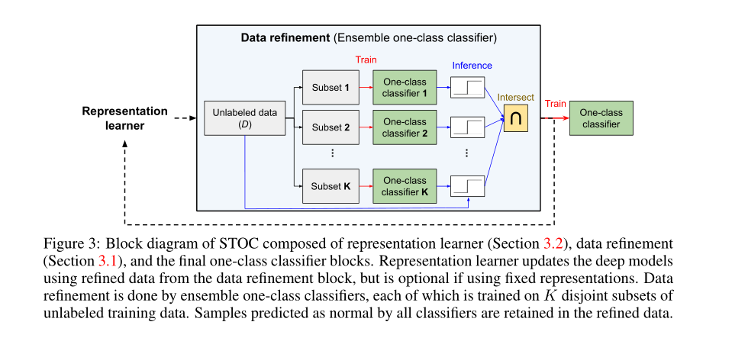
Self-Trained One-class Classification for Unsupervised Anomaly Detection - STOC
Inspired by the recent success of self-training in learning without labels [7, 45], we propose a novel self-trained one-class classification (STOC) framework.
[7] D. Berthelot, N. Carlini, I. Goodfellow, N. Papernot, A. Oliver, and C. Raffel. Mixmatch: Aholistic approach to semi-supervised learning. arXiv preprint arXiv:1905.02249, 2019. 2, 3
[45] Q. Xie, M.-T. Luong, E. Hovy, and Q. V. Le. Self-training with noisy student improves imagenet classification. In Proceedings of the IEEE/CVF Conference on Computer Vision and Pattern Recognition, pages 10687–10698, 2020.

Slide 9
nova

Slide 10
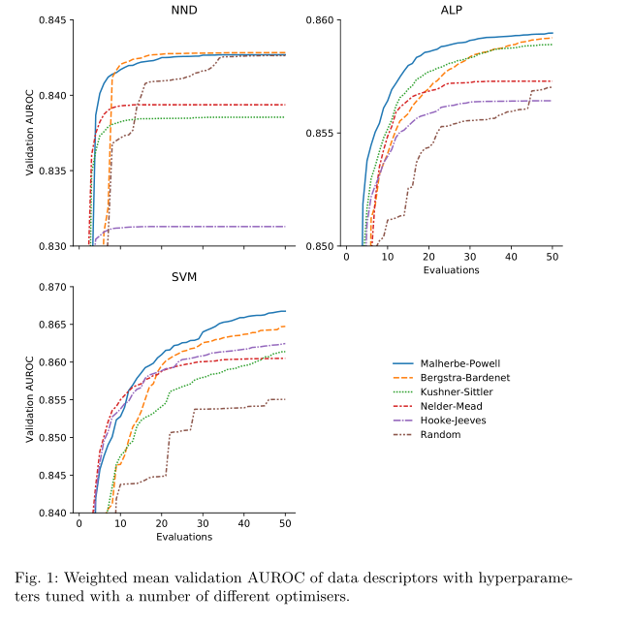
Optimised one-class classification performance

Slide 11
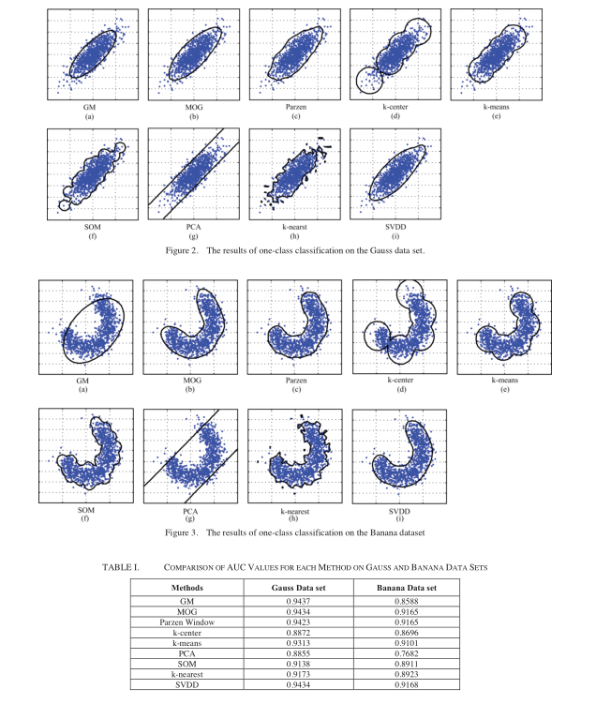
Overview of one-Class Classification
At present, the one-class classification methods are mainly divided into three types: density-based methods (Gaussian model, mixed Gaussian model [19] and Parzen density model),
reconstruction-based methods (k-center, k-means, PCA one-class classification [20] and self-organizing mapping method [21].), and
boundary-based methods (k-nearest neighbor method, one-class support vector machine,(OCSVM) and SVDD.).
Sintesed data: Gaussian and Banana

Slide 12
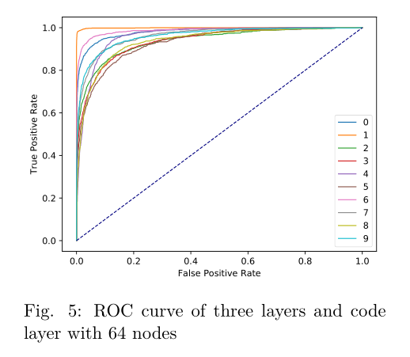
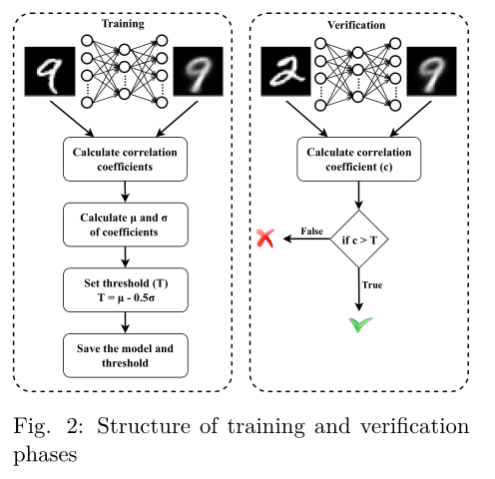
Autoencoder-based One-class Classification
Such classification techniques usually output the closest class label for any given input – NO, you need to classify values only lies in distributions (e.g. authentication)
SVDD, which finds the smallest hypersphere that contains all objects of a specific class, and one-class SVM (OC-SVM), which separates inliers from outliers by finding a hyperplane of maximal distance from the origin.

Slide 13
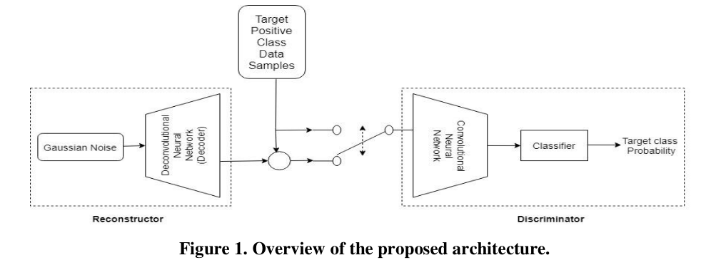
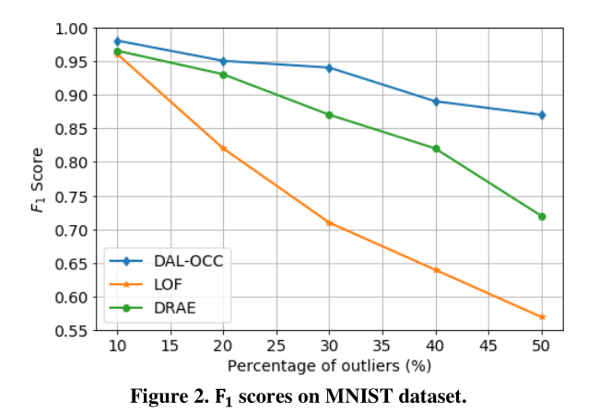
One-Class Classification with Deep Adversarial Learning
The generator network contains a Deconvolutional Neural Networks (aka. decoder), which is trained using a zero-centered Gaussian noise as the feature representation of the pseudo-negative class to learn a good representation as well as the boundary for the classifiable distortion of the target (or positive) class with the assistance from the target class. The outputs produced by the generator network are aggregated with the real positive class data samples, which are then used to train the discriminator network, whose goal is to understand the underlying concept in the positive class, and then classify the negative testing samples.
Lof: identifying density-based local outliers
Learning discriminative reconstructions for unsupervised outlier removal.

Slide 14
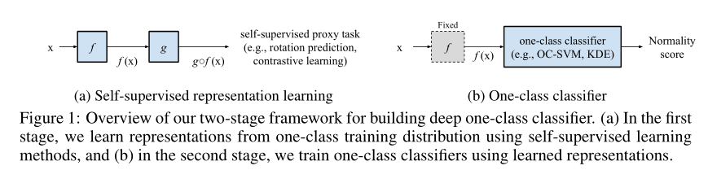
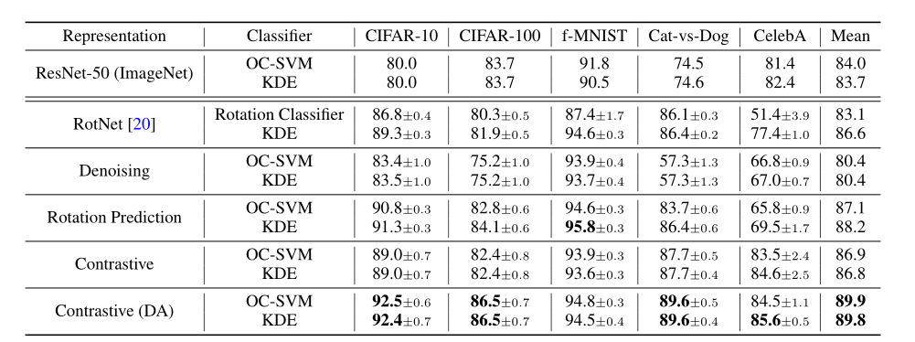
LEARNING AND EVALUATING REPRESENTATIONS FOR DEEP ONE-CLASS CLASSIFICATION
two-stage framework for deep one-class classification. We first learn self-supervised representations from one-class data, and then build one-class classifiers on learned representations.

Slide 15
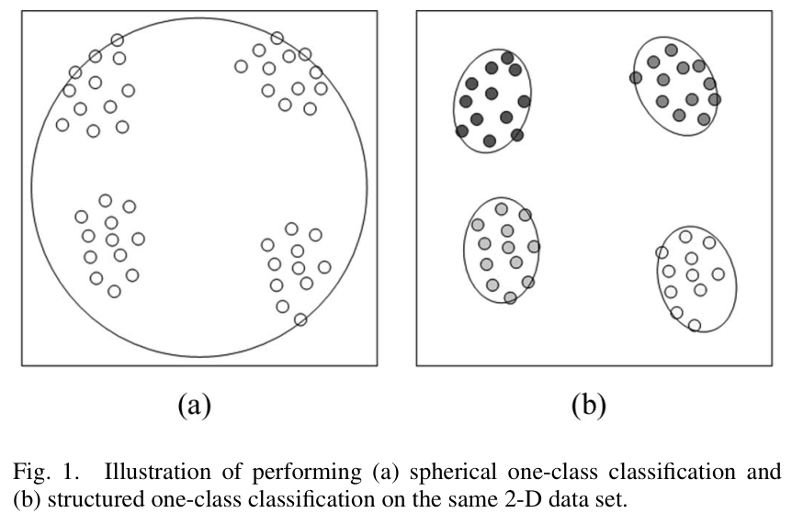
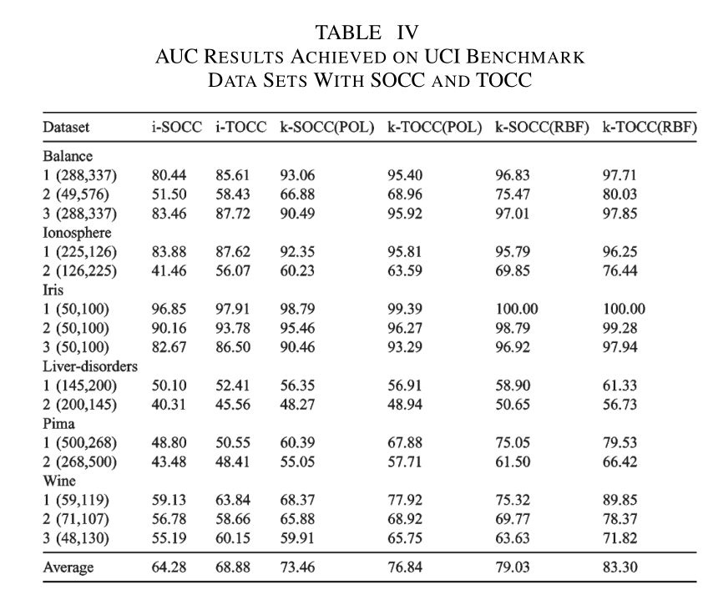
Structured One-Class Classification
The spherical one-class classifier (SOCC) solves this problem by finding a hypersphere with minimum volume that contains the target data while keeping outlier samples outside.
structured one-class classifier (TOCC) - to exploit target data structures obtained via unsupervised methods such as agglomerative hierarchical clustering and use them in calculating a set of hyperellipsoidal separating boundaries.

Slide 16
(more about domain) One class classification with application to forensic analysis
We propose to consider Gini’s classical transvariation probability as a measure of typicality, i.e. a measure of resemblance between an observation and a set of well- known objects (the control cases). The aim of the proposed transvariation-based one-class classifier is to identify the best boundary around the target class, i.e. to recognize as many target objects as possible while rejecting all those deviating from this class.

